Slide 1
Bella and I
Adventure’s Down Croatan Rd.
By Katrina Hughes

Slide 2
When I leave with my dog from our humble abode,
We start our long walk down Croatan Road

Slide 3
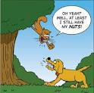
My dog’s name is Bella (I named her myself),
And if there’s a squirrel, you can be sure that she’ll tell-a

Slide 4
We walk on and on and there’s nothing to see;
Some houses, some road, and Bella and me

Slide 5
We’re at the end of our road, its time to go back
But that’s when I heard it, a resounding THWACK!

Slide 6
I look to my right, there’s nothing in sight.
But Bella’s loud barking left me with a fright!
I look to my left, and boy was she right

Slide 7
A big scary beast, green like a toad!
Came hurling at me down Croatan road

Slide 8
We ran and ran, but Bella was faster
She took off so that beast couldn’t catch her

Slide 9
Reminding myself not to give her more treats,
I took off going straight past two streets

Slide 10
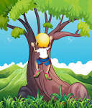
The beast was behind me; I had to think fast
I climbed up a tree hoping the beast wouldn’t last

Slide 11
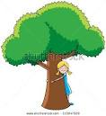
I think it’s the end- but wait! What’s that!?
It could be a hen; or is it a cat?

Slide 12
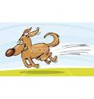
It’s Bella! It’s Bella! I knew she’d come back!
She’s running full speed right down the track.

Slide 13
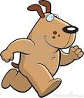
She barks once, three times, not once has she slowed
Barking and running down Croatan road

Slide 14
The beast’s run away!
We’ll see another day!

Slide 15
I’ve changed my mind Bella!
Scaring off that great beast,
Deserves you a whole feast

Slide 16
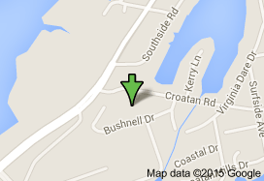
Croatan Road

